Slide 1
Course Code: CSC211A Course Title: Formal Languages and Automata Theory
Lecture 28: Pumping Lemma for CFL-2
Course Leader:
Prakash P
prakashp.cs.et@msruas.ac.in

Slide 2
Session Objectives
At the end of this session, student will be able
Explain non-context free languages
Apply pumping lemma to prove that the given language is context free

Slide 3
Session Topics
Non-context free languages
Pumping lemma to prove that the given language is context free

Slide 4
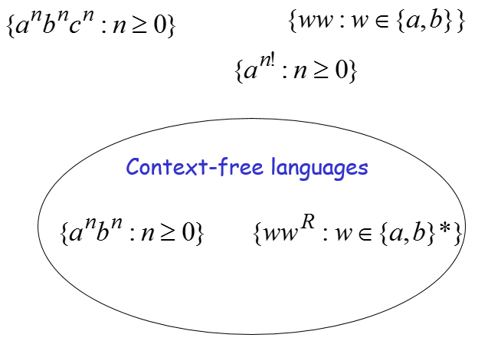
Non-Context Free Languages

Slide 5
Non-Context Free Languages
Theorem:
The language
is not context free
Proof:
Use the Pumping Lemma for context-free languages

Slide 6
Non-Context Free Languages
Assume for contradiction that
is context-free
Since is context-free and infinite we can apply the pumping lemma

Slide 7
Non-Context Free Languages
Pumping Lemma gives a magic number
such that:
Pick any string of with length at least
we pick:

Slide 8
Non-Context Free Languages
We can write:
with lengths and
Pumping Lemma says:
for all

Slide 9
Non-Context Free Languages
We examine all the possible locations of string in
There is only one case to consider

Slide 10
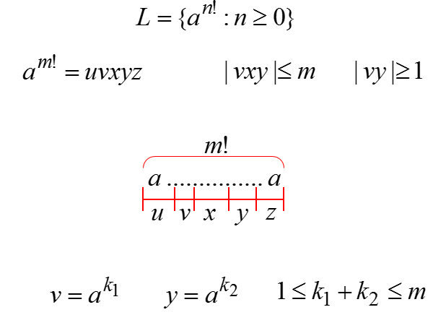
Non-Context Free Languages

Slide 11
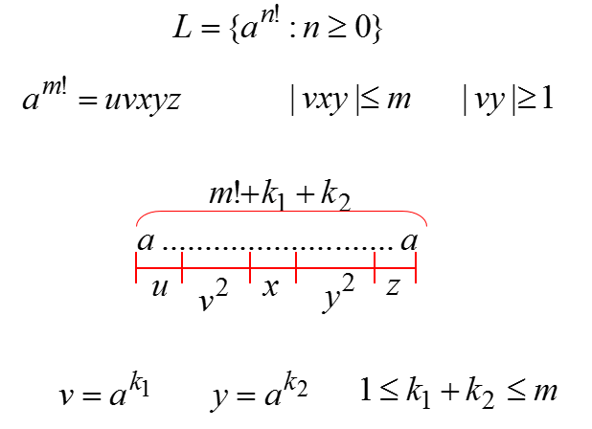
Non-Context Free Languages

Slide 12
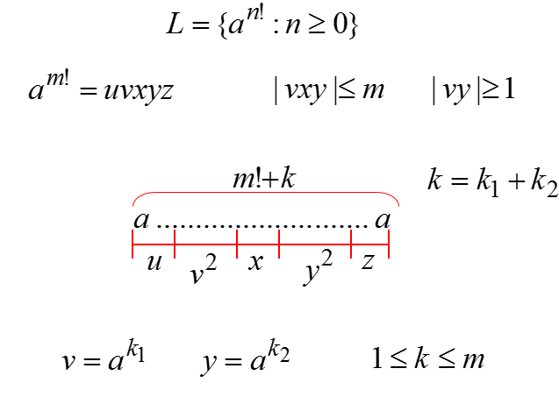
Non-Context Free Languages

Slide 13
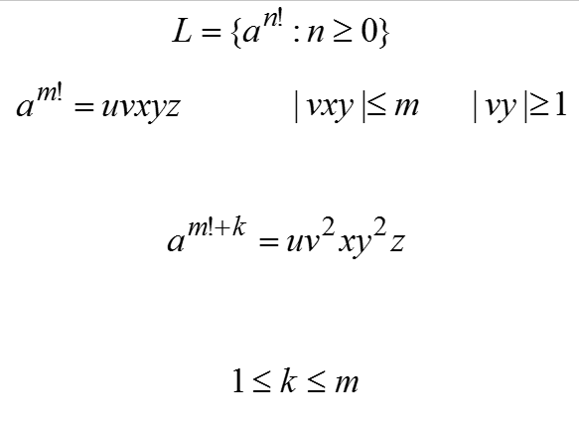
Non-Context Free Languages

Slide 14
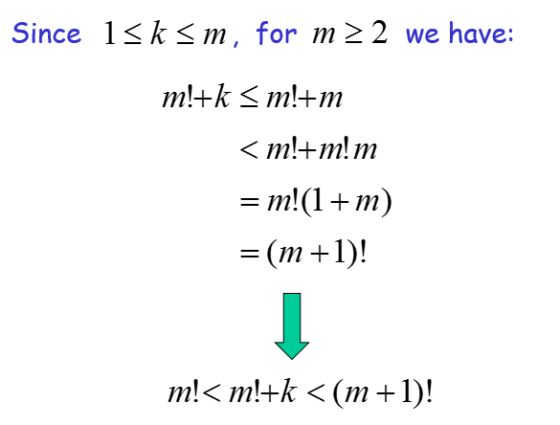
Non-Context Free Languages

Slide 15
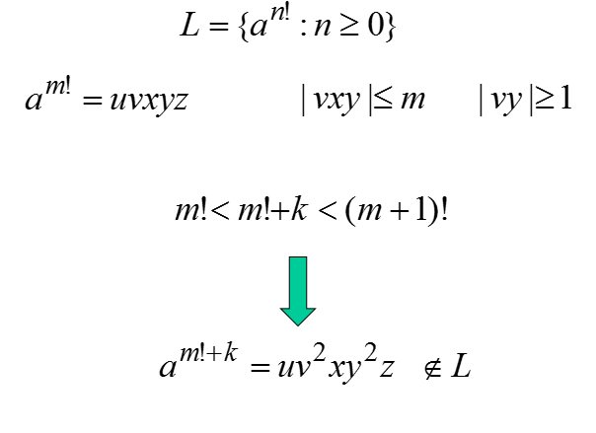
Non-Context Free Languages

Slide 16
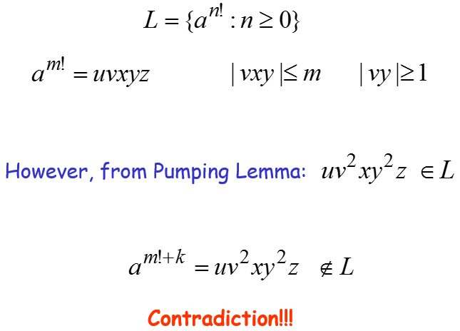
Non-Context Free Languages

Slide 17
Non-Context Free Languages
We obtained a contradiction
Therefore:
The original assumption that
is context-free must be wrong
Conclusion:
is not context-free

Slide 18
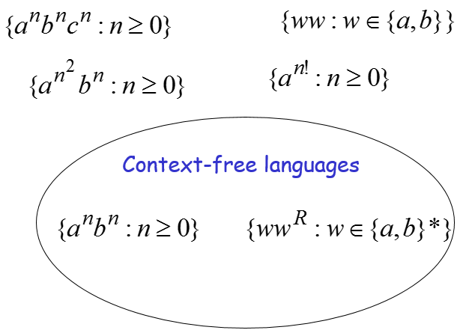
Non-Context Free Languages

Slide 19
Non-Context Free Languages
Theorem:
The language
is not context free
Proof:
Use the Pumping Lemma for context-free languages

Slide 20
Non-Context Free Languages
Assume for contradiction that
is context-free
Since is context-free and infinite we can apply the pumping lemma

Slide 21
Non-Context Free Languages
Pumping Lemma gives a magic number such that:
Pick any string of with length at least
we pick:

Slide 22
Non-Context Free Languages
We can write:
with lengths and
Pumping Lemma says:
for all

Slide 23
Non-Context Free Languages
We examine all the possible locations
of string in

Slide 24
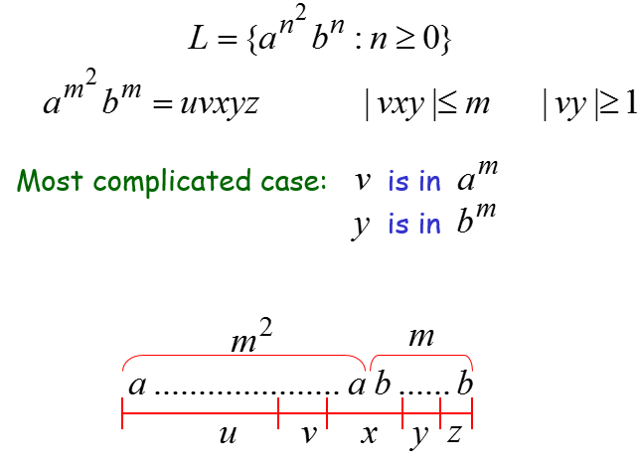
Non-Context Free Languages

Slide 25
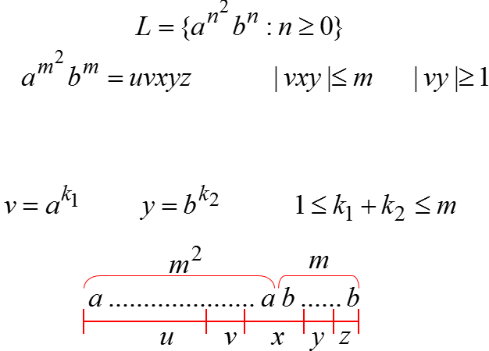
Non-Context Free Languages

Slide 26
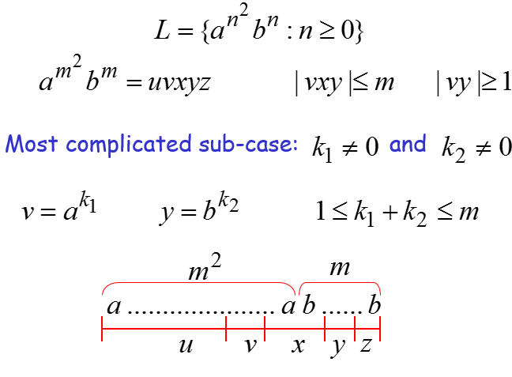
Non-Context Free Languages

Slide 27
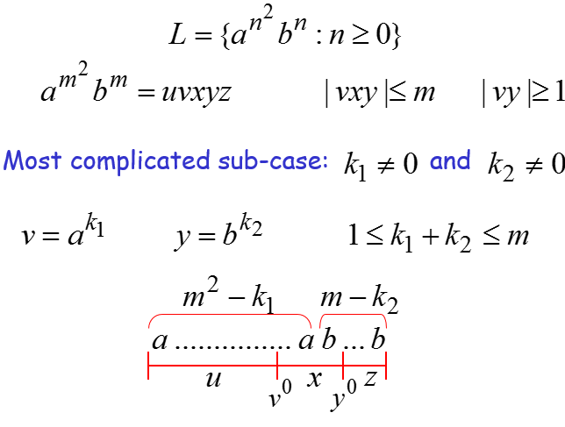
Non-Context Free Languages

Slide 28
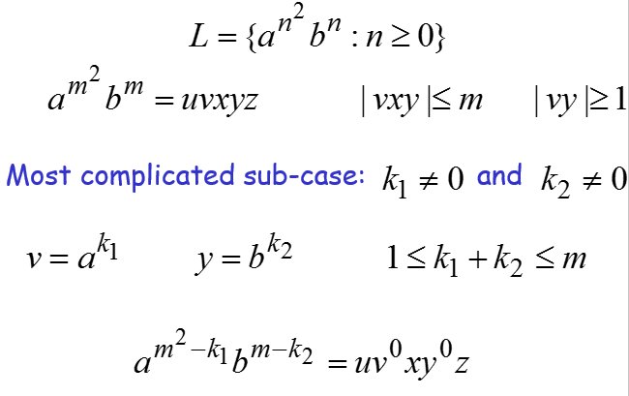
Non-Context Free Languages

Slide 29
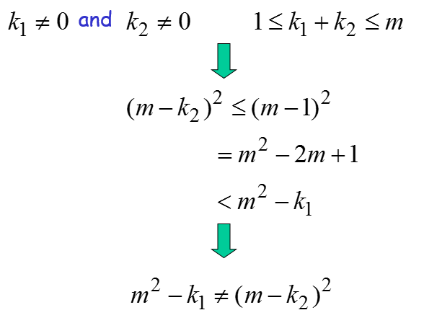
Non-Context Free Languages

Slide 30
Non-Context Free Languages

Slide 31
Non-Context Free Languages
However, from Pumping Lemma:
Contradiction!!!

Slide 32
Non-Context Free Languages
When we examine the rest of the cases
we also obtain a contradiction

Slide 33
Non-Context Free Languages
In all cases we obtained a contradiction
Therefore:
The original assumption that
is context-free must be wrong
Conclusion:
is not context-free

Slide 34
Summary
Pumping lemma is used to prove that the given language is context free

